Slide 1
The Dining Philosophers Problem
Joseph Tierney, Nikolaos Vourdanos, Jessica Tati and Adam McCarthy

Slide 2
Our Solution – Mutex
- Involves locking and unlocking
- Philosopher will lock the chopstick to their left first, followed the right if available
- Other Philosopher’s will have to wait.
- Can cause deadlock!

Slide 3
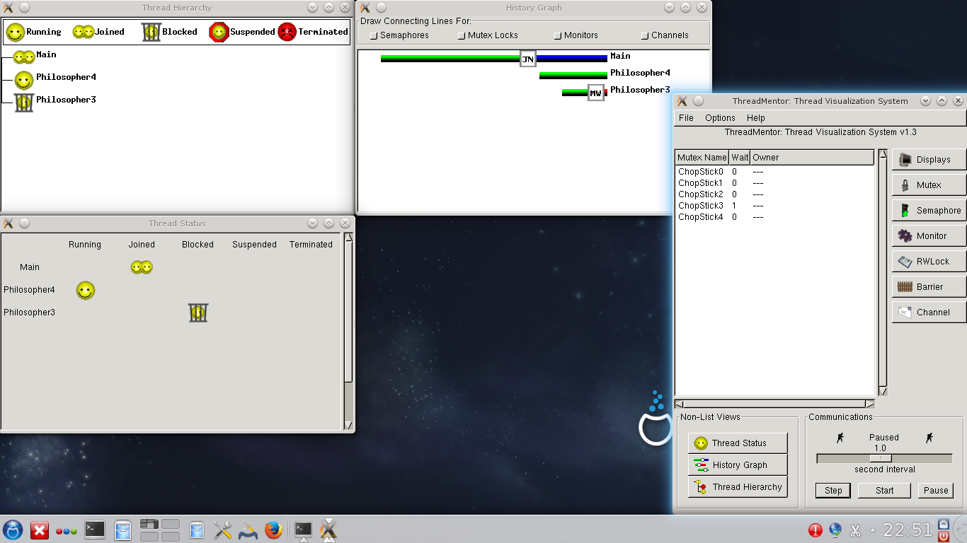

Slide 4


Slide 5


Slide 6
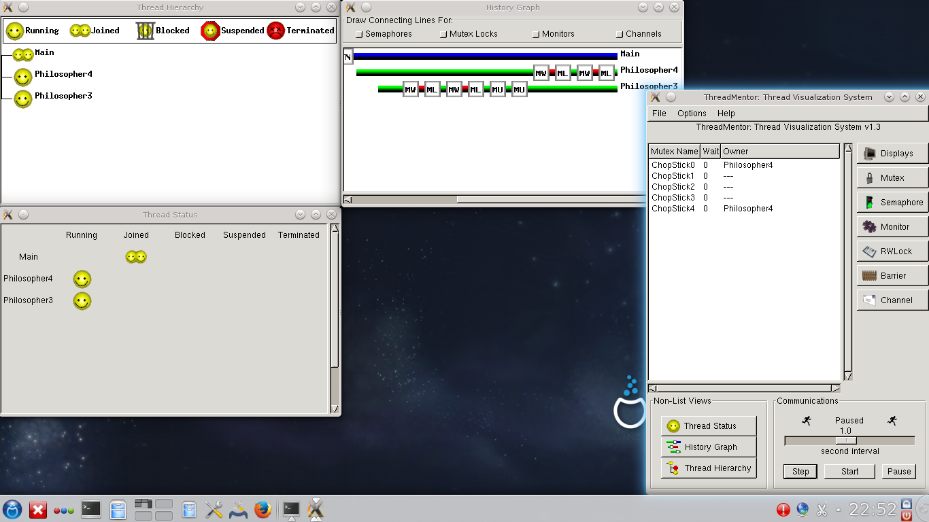

Slide 7
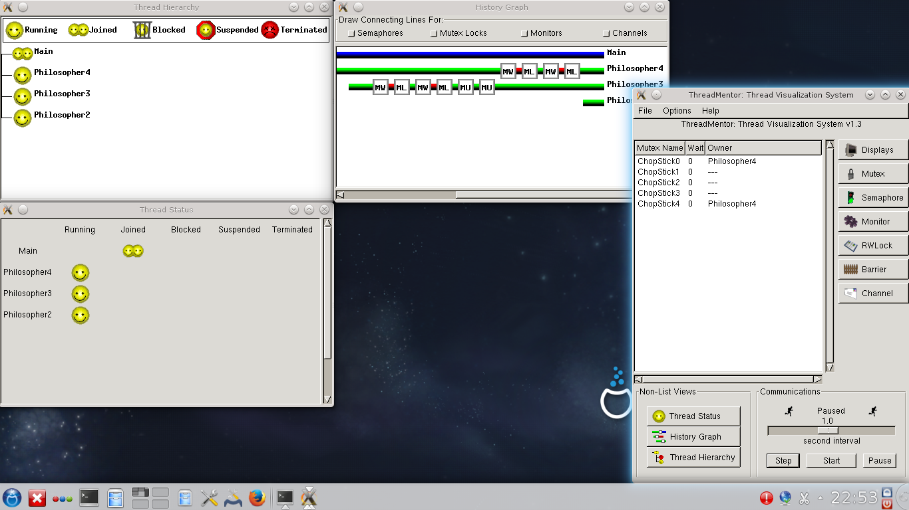

Slide 8
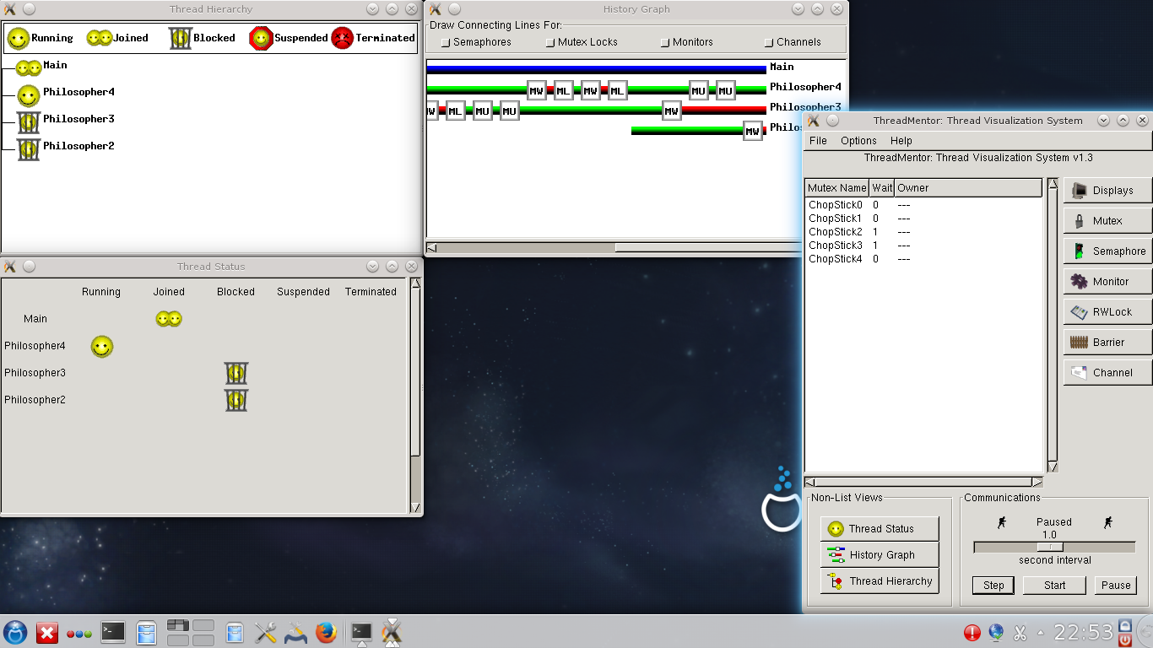

Slide 9
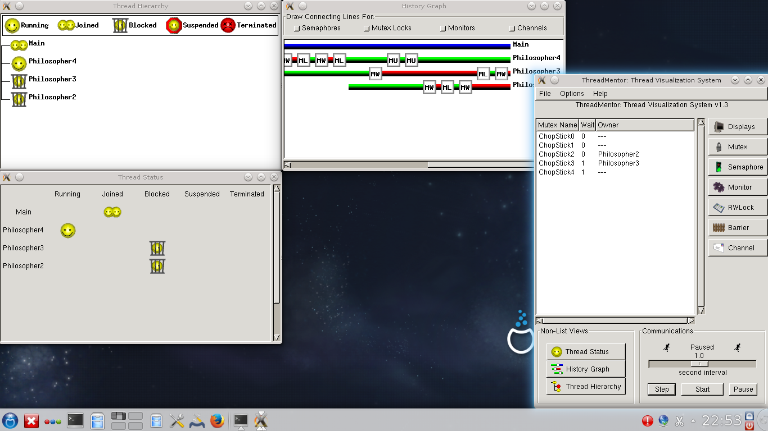

Slide 10


Slide 11


Slide 12
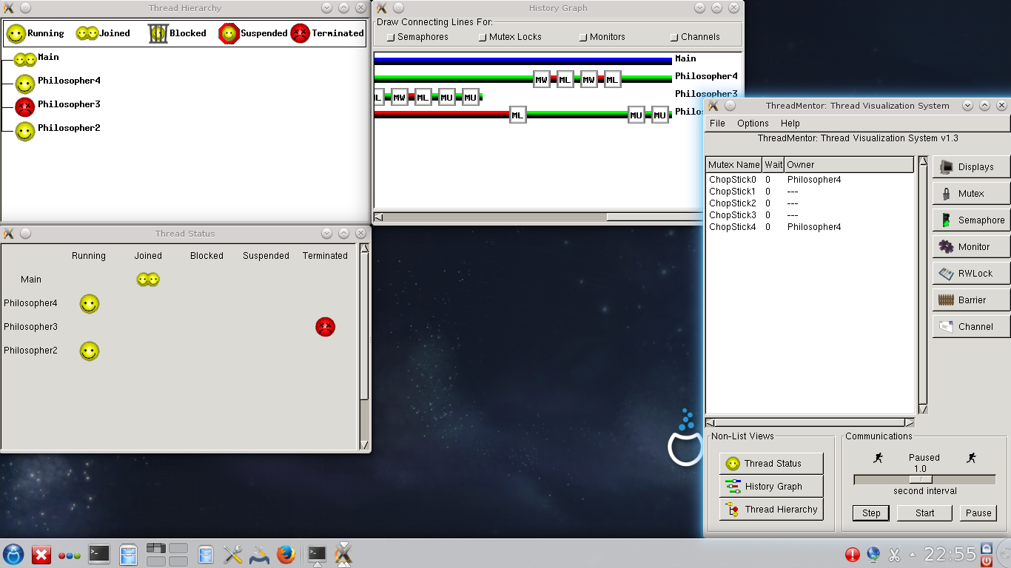

Slide 13
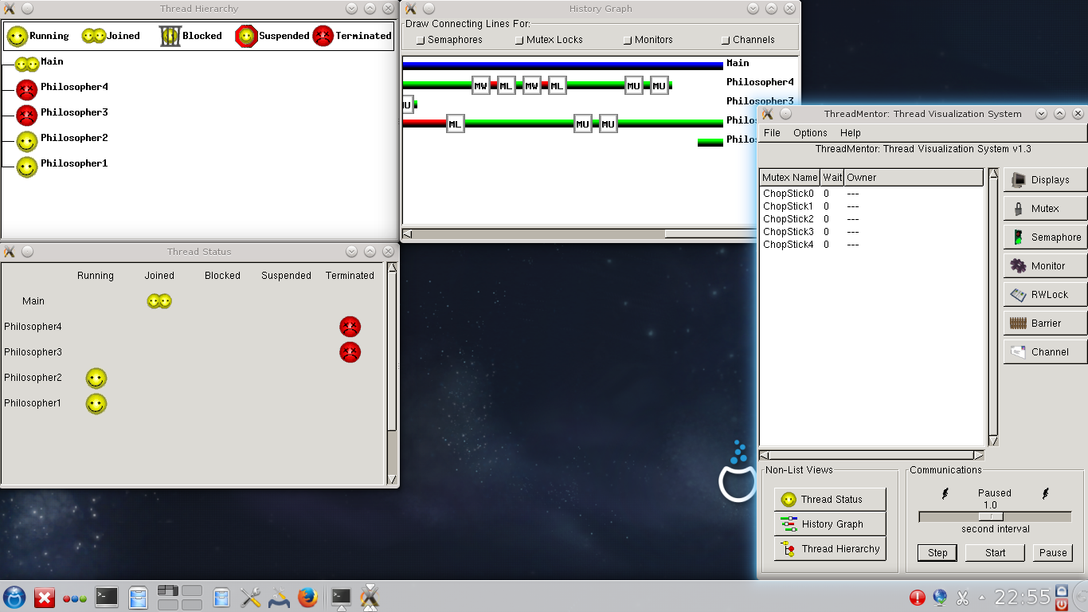

Slide 14


Slide 15
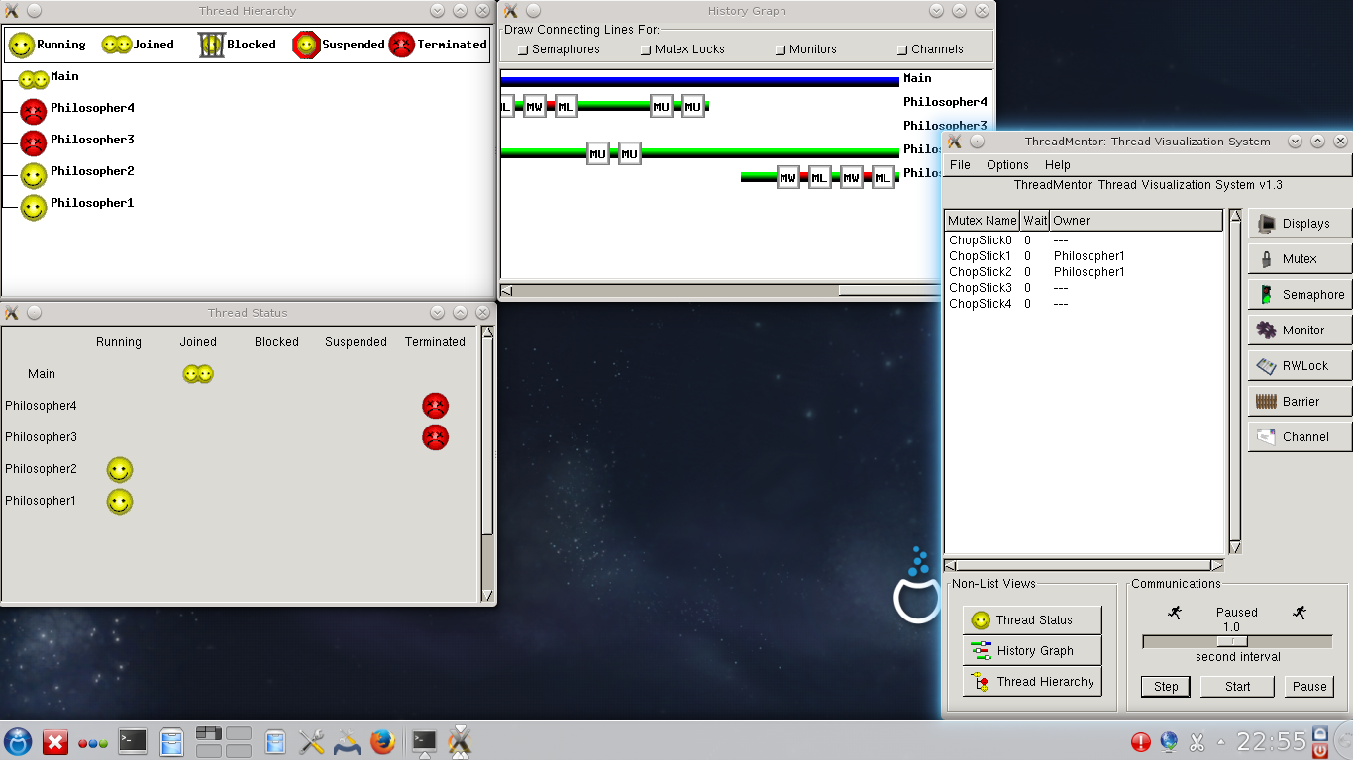

Slide 16


Slide 17
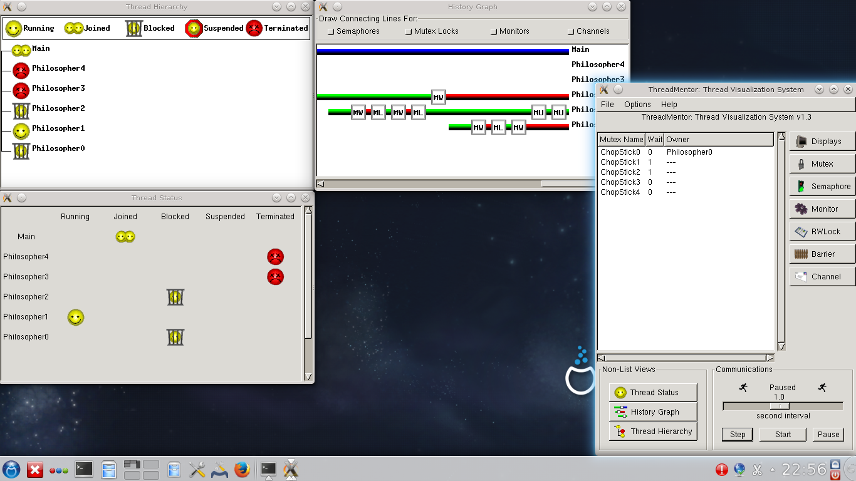

Slide 18
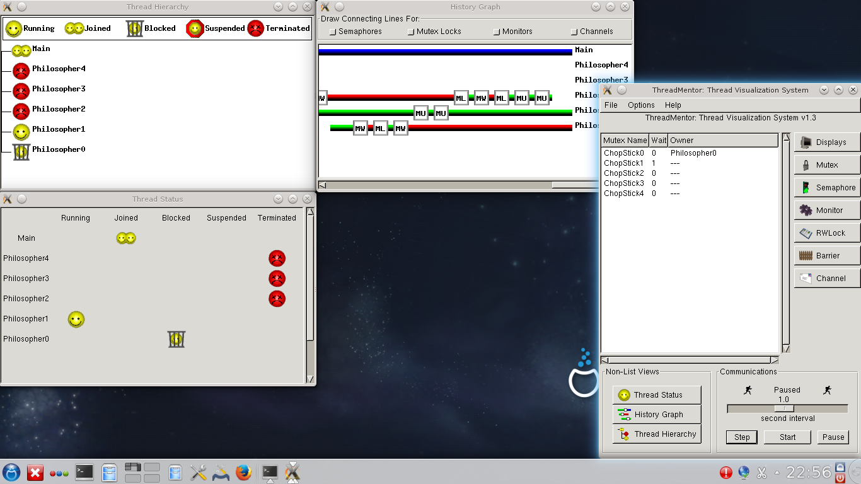

Slide 19


Slide 20
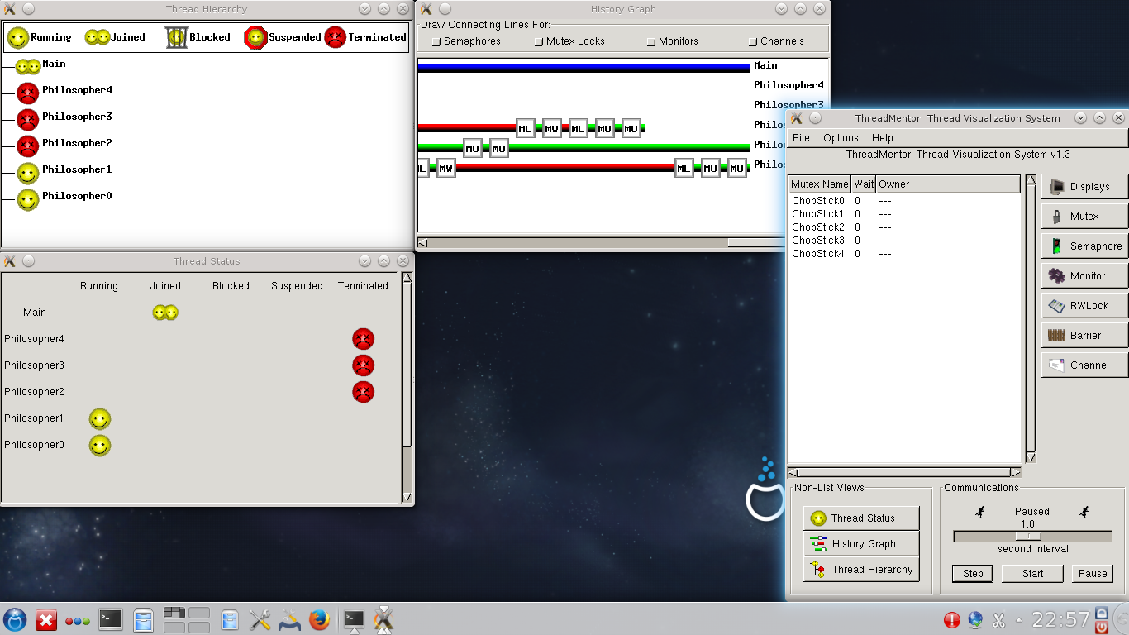

Slide 21
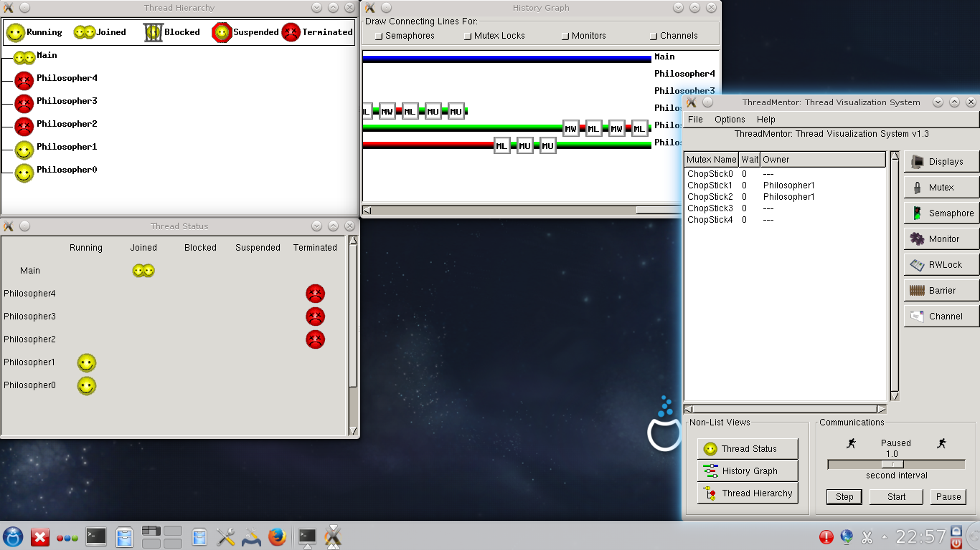

Slide 22


Slide 23


Slide 24


Slide 25
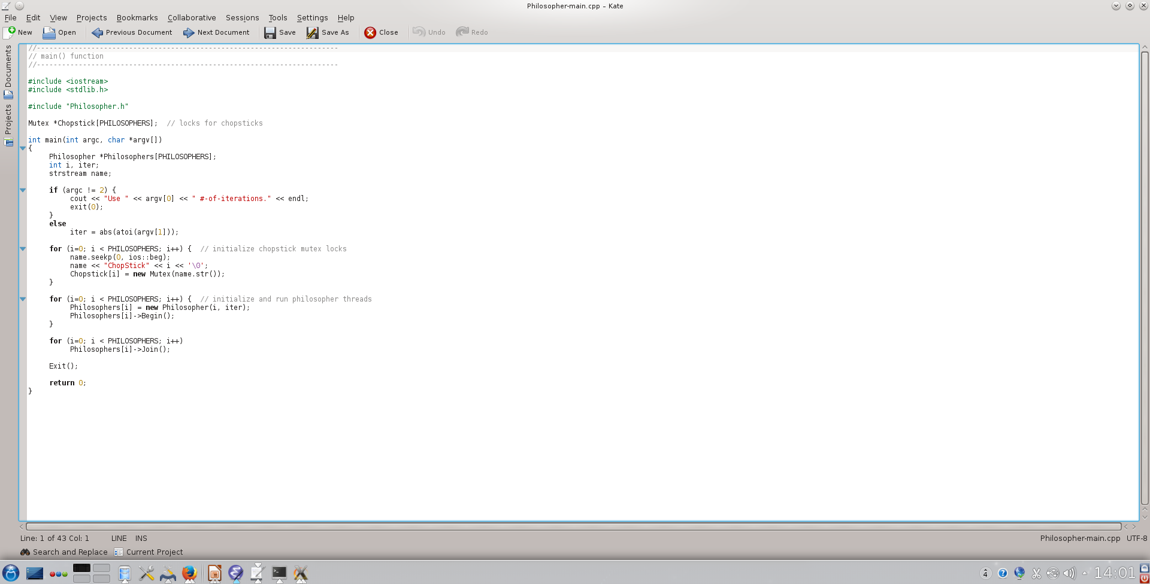

Slide 26
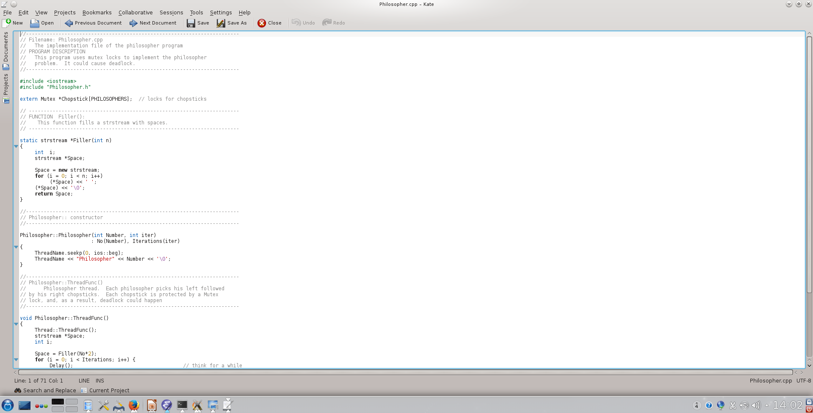

Slide 27
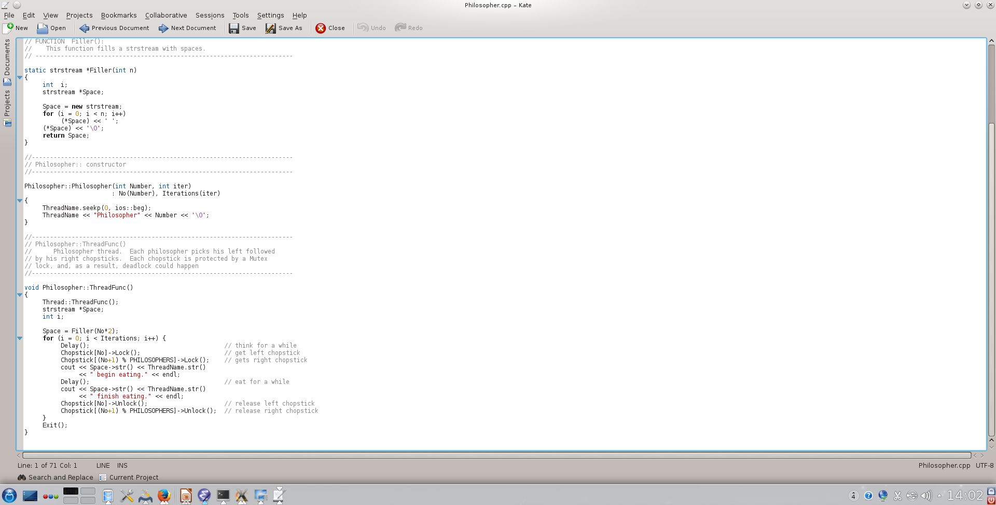

Slide 28
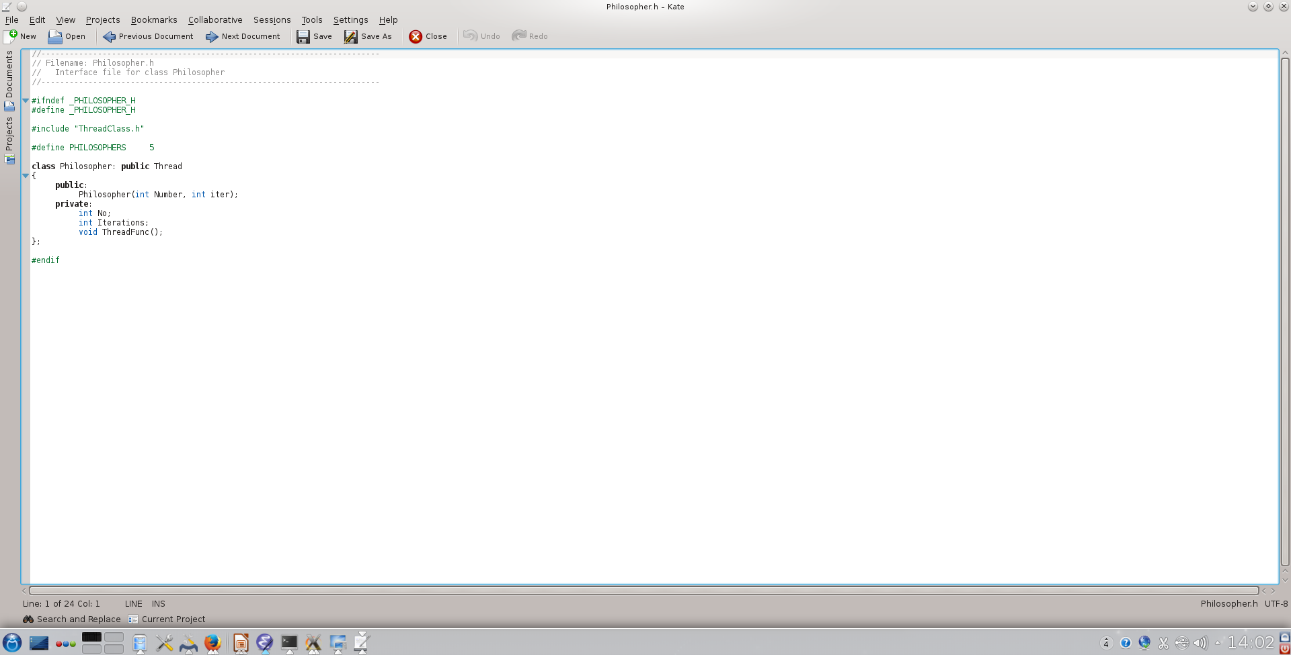

Slide 29
Questions?

